Slide 1
Mid-Project Status Report
Group-L (www.ShopfromHome.com)
Raviteja Sankuratri
Harshith Rapala
Sai Krishna Abburi
Venkata Sai Bhargava Reddy Cheruku
Dhaman Kumar Kakke

Slide 2
Content
Team Members
Brief Introduction
Technologies Used
Tasks Implemented - Phase 1
Application Screenshots
Problems Faced & Action Items
Remaining Work (for Phase-2)
Gantt Chart (Updated as of 04/16/2019)

Slide 3
Team Members
Dhaman Kumar Kakke (Manager)
Raviteja Sankuratri
Sai Krishna Abburi
Venkata Sai Bhargava Reddy Cheruku
Harshith Rapala

Slide 4
Brief Introduction
Our website is an organic grocery store, which enables anyone to open an account and order the products.
Our customers have ability to order products, add products to cart for future ordering.
For now, our website contains organic products and can be extended to other product types.

Slide 5
Technology used
WordPress
Other plugins to avoid/safeguard for :
SQL injection, HTTPS, XSS, and payment gateway etc.
Disaster Recovery.

Slide 6
Tasks Implemented - Phase 1 (Current Status)
Project Setup
Created user interface that allows admins to post products with their details
UI for user to access products and make purchases
Filtering the products based on their category
Implemented Cart and Checkout features
Implemented validations during the checkout process.

Slide 7
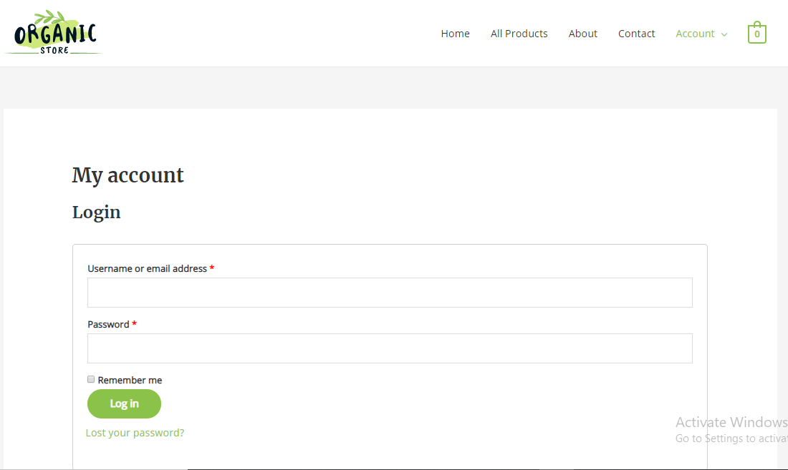
Application Screenshot - User Login Page

Slide 8
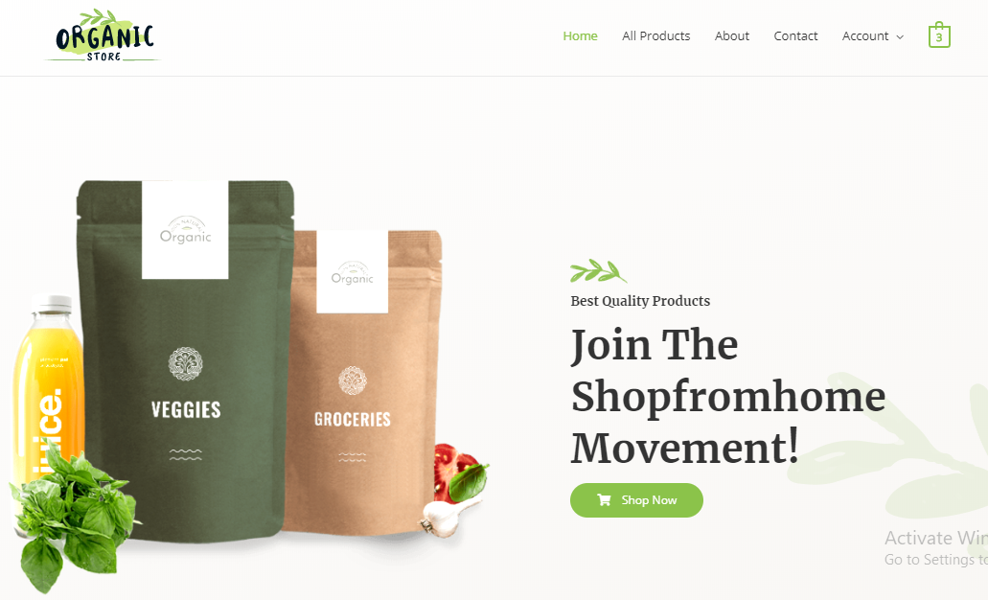
Application Screenshots - User Home

Slide 9
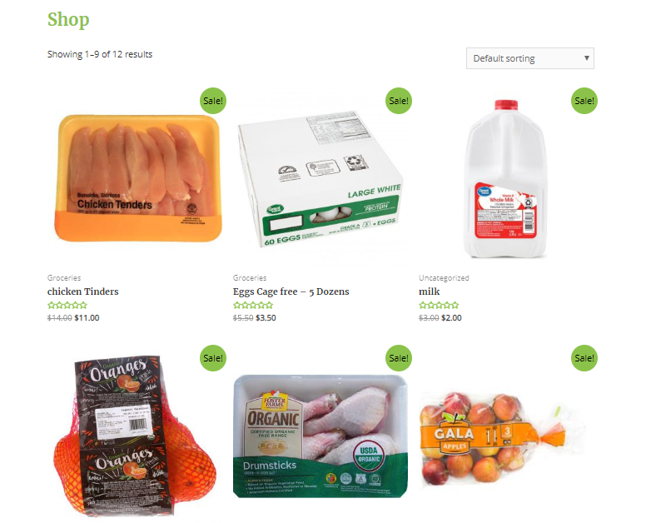
Application Screenshot - Products

Slide 10
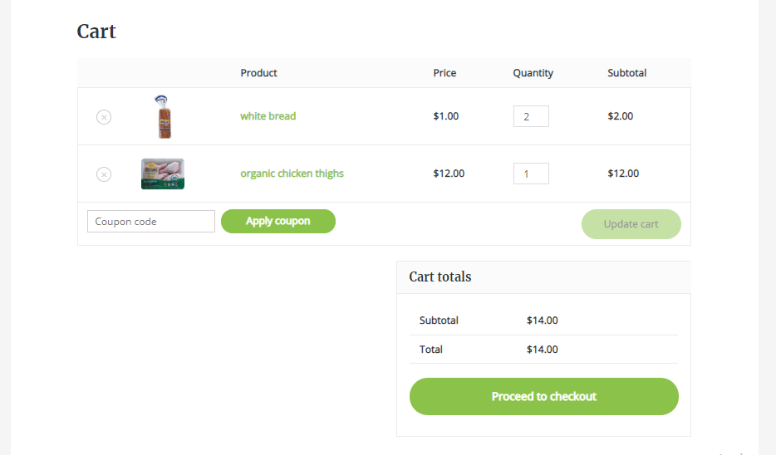
Application Screenshots - Cart

Slide 11
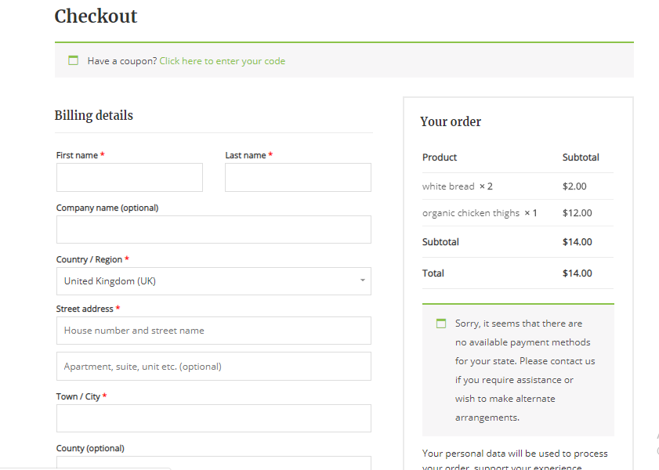
Application Screenshots - Checkout

Slide 12
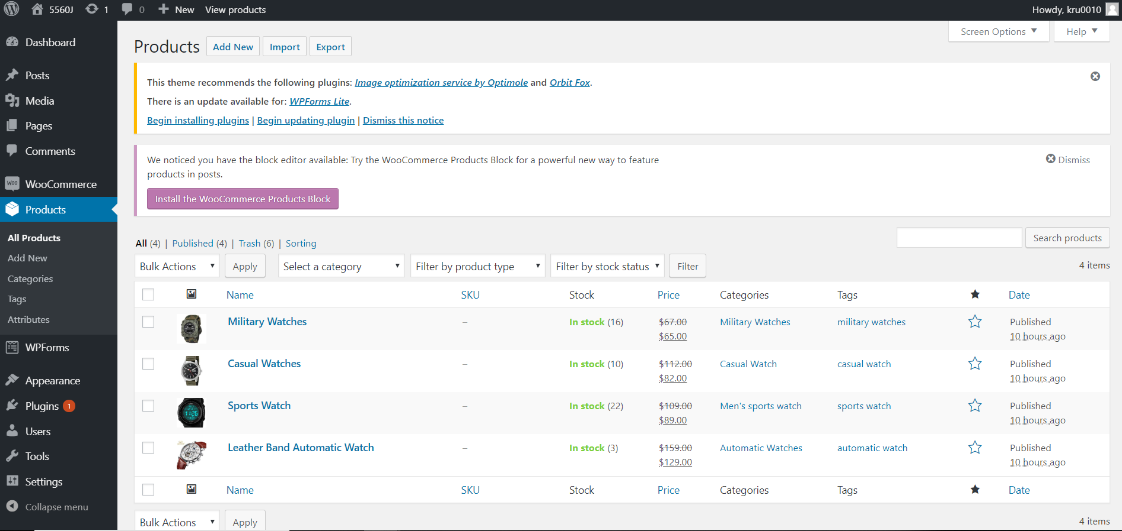
Application Screenshot - Admin Page

Slide 13
Issues & Resolutions
Took time for project setup as we had to learn WordPress.
As our Cse machines runs on lower version of php, so we are unable to get the latest version plugins.
As this phase was mostly focused on the functionality implementation rather than security so it went smooth, but we predict that we might have to deal with any issues in the second phase where we implement security features in our project.
Resolutions:
We took a shot at our engineering and advancements utilized with the end goal that they are doable to execute better security highlights. We will keep exploring our usage example and attempt to anticipate any issues before hand.

Slide 14
Remaining Work (for Phase-2)
Functional requirements are implemented as part of Phase-1. Below is the major component to be implemented in Phase-2:
Security Features
Paypal Integration
Disaster Recovery
If time permits:
Filtering products based on location
Mobile Responsive Check
Review implementation plan before starting Phase-2

Slide 15
Gantt Chart (as of 04/16/2020)
Task | Deadline | Estimated Time (In Days) | Actual Time (In Days)
Project Plan | 03/06/2020 | 2 | 2
Project Setup | 04/09/2020 | 3 | 3
Phase 1 Development | 04/14/2020 | 5 | 5
Mid Project Status | 04/16/2020 | 1 | 1
Phase 2 Development | 04/28/2020 | 12
Presentation | 04/28/2020 | 1
Hackathon | 04/30/2020 | 1

Slide 16
Thank you
Have a nice day!

